Slide 1
K-Means Clustering and Gaussian Mixture Model
Il-Chul Moon
Dept. of Industrial and Systems Engineering
KAIST
icmoon@kaist.ac.kr

Slide 2
Weekly Objectives
Understand the clustering task and the K-means algorithm
  Know what the unsupervised learning is
  Understand the K-means iterative process
  Know the limitation of the K-means algorithm
Understand the Gaussian mixture model
  Know the multinomial distribution and the multivariate Gaussian distribution
  Know why mixture models are useful
  Understand how the parameter updates are derived from the Gaussian mixture model
Understand the EM algorithm
  Know the fundamentals of the EM algorithm
  Know how to derive the EM updates of a model

Slide 3
EM algorithm

Slide 4
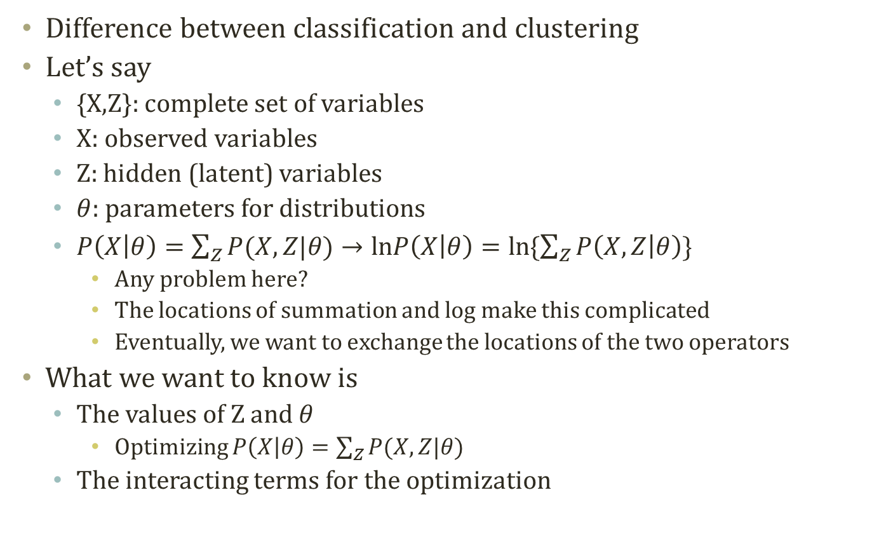
Inference with Latent Variables
Difference between classification and clustering
Let’s say
  {X,Z}: complete set of variables
  X: observed variables
  Z: hidden (latent) variables
  $θ$: parameters for distributions
  $P\left(X | θ\right)=\sum_{Z}{P(X,Z|θ)}→lnP\left(X | θ\right)=ln\{\sum_{Z}{P\left(X,Z | θ\right)}\}$
    Any problem here?
    The locations of summation and log make this complicated
    Eventually, we want to exchange the locations of the two operators
What we want to know is
  The values of Z and $θ$
    Optimizing $P\left(X | θ\right)=\sum_{Z}{P(X,Z|θ)}$
  The interacting terms for the optimization

Slide 5
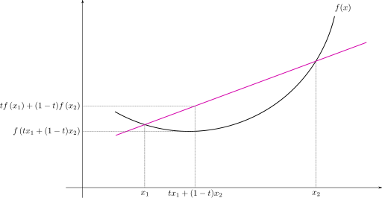
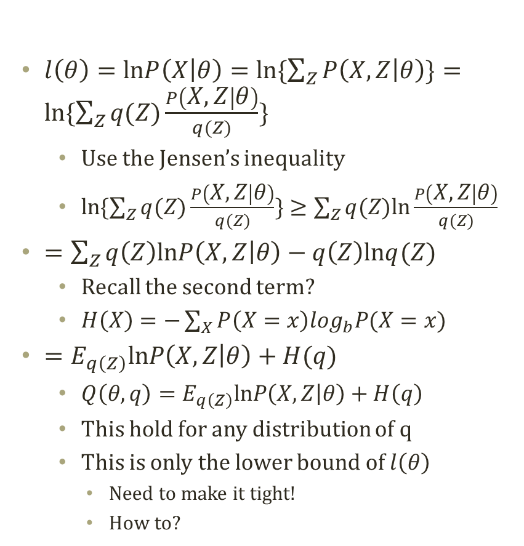
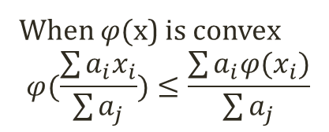
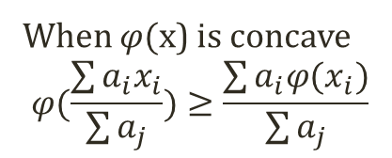
Probability Decomposition
  $l\left(θ\right)=lnP\left(X | θ\right)=ln\{\sum_{Z}{P\left(X,Z | θ\right)}\}=ln\{\sum_{Z}{q(Z)\frac{P\left(X,Z | θ\right)}{q(Z)}}\}$
    Use the Jensen’s inequality
    $ln\{\sum_{Z}{q(Z)\frac{P\left(X,Z | θ\right)}{q(Z)}}\}≥\sum_{Z}{q(Z)ln\frac{P\left(X,Z | θ\right)}{q(Z)}}$
  $=\sum_{Z}{q\left(Z\right)lnP\left(X,Z | θ\right)−q\left(Z\right)lnq(Z)}$
    Recall the second term?
    $H\left(X\right)=−\sum_{X}{P\left(X=x\right)\log_{b}P(X=x)}$
  $=E_{q\left(Z\right)}lnP\left(X,Z | θ\right)+H(q)$
    $Q\left(θ,q\right)=E_{q\left(Z\right)}lnP\left(X,Z | θ\right)+H\left(q\right)$
    This hold for any distribution of q
    This is only the lower bound of $l\left(θ\right)$
      Need to make it tight!
      How to?
Jensen’s Inequality
When $φ($x) is concave
$$φ(\frac{\sum{a_{i}x_{i}}}{\sum{a_{j}}})≥\frac{\sum{a_{i}φ(x_{i}})}{\sum{a_{j}}}$$
When $φ($x) is convex
$$φ(\frac{\sum{a_{i}x_{i}}}{\sum{a_{j}}})≤\frac{\sum{a_{i}φ(x_{i}})}{\sum{a_{j}}}$$

Slide 6
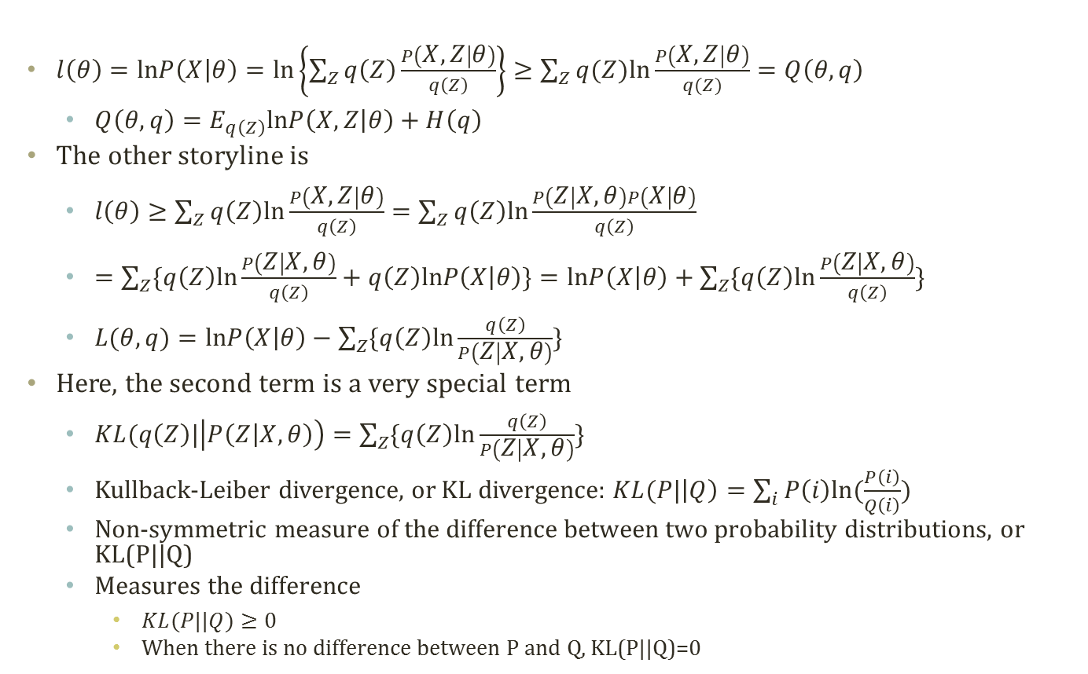
Maximizing the Lower Bound (1)
  $l\left(θ\right)=lnP\left(X | θ\right)=ln\left\{\sum_{Z}{q\left(Z\right)\frac{P\left(X,Z | θ\right)}{q\left(Z\right)}}\right\}≥\sum_{Z}{q(Z)ln\frac{P\left(X,Z | θ\right)}{q(Z)}}=Q\left(θ,q\right)$
  $Q\left(θ,q\right)=E_{q\left(Z\right)}lnP\left(X,Z | θ\right)+H\left(q\right)$
The other storyline is
  $l\left(θ\right)≥\sum_{Z}{q\left(Z\right)ln\frac{P\left(X,Z | θ\right)}{q\left(Z\right)}}=\sum_{Z}{q\left(Z\right)ln\frac{P\left(Z | X,θ\right)P\left(X | θ\right)}{q\left(Z\right)}}$
  $=\sum_{Z}{\{q\left(Z\right)ln\frac{P\left(Z | X,θ\right)}{q\left(Z\right)}+q\left(Z\right)lnP\left(X | θ\right)\}}=lnP\left(X | θ\right)+\sum_{Z}{\{q\left(Z\right)ln\frac{P\left(Z | X,θ\right)}{q\left(Z\right)}\}}$
  $L(θ,q)=lnP\left(X | θ\right)−\sum_{Z}{\{q\left(Z\right)ln\frac{q\left(Z\right)}{P\left(Z | X,θ\right)}\}}$
Here, the second term is a very special term
  $KL(q\left(Z\right)|\left|P\left(Z | X,θ\right)\right)=\sum_{Z}{\{q\left(Z\right)ln\frac{q\left(Z\right)}{P\left(Z | X,θ\right)}\}}$
  Kullback-Leiber divergence, or KL divergence: $KL(P|\left|Q\right)=\sum_{i}{P\left(i\right)ln⁡(\frac{P\left(i\right)}{Q\left(i\right)})}$
  Non-symmetric measure of the difference between two probability distributions, or KL(P||Q)
  Measures the difference
    $KL(P||Q)≥0$
    When there is no difference between P and Q, KL(P||Q)=0

Slide 7
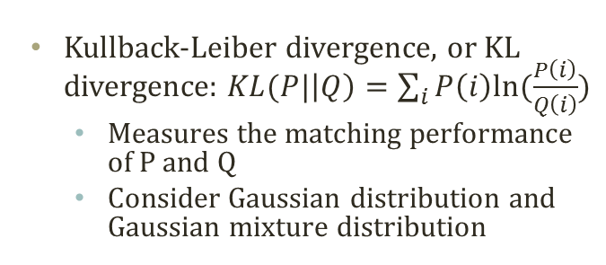
KL Divergence
Distribution Q2
Kullback-Leiber divergence, or KL divergence: $KL(P|\left|Q\right)=\sum_{i}{P\left(i\right)ln⁡(\frac{P\left(i\right)}{Q\left(i\right)})}$
  Measures the matching performance of P and Q
  Consider Gaussian distribution and Gaussian mixture distribution
KL(P||Q2)=0.0104
KL(Q2||P)=0.0101
Distribution P
Distribution Q1
KL(P||Q1)=0.5440
KL(Q1||P)=0.9835

Slide 8

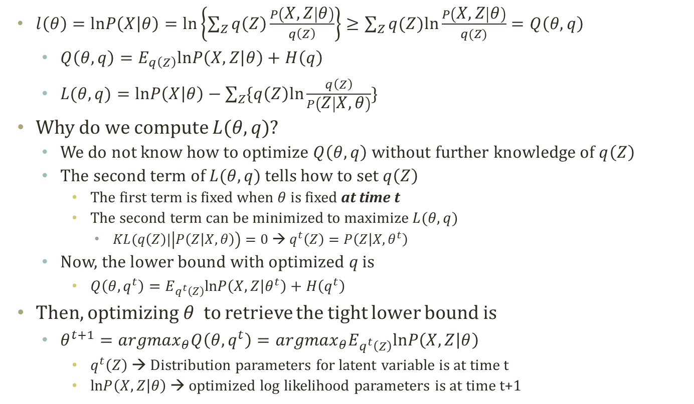

Maximizing the Lower Bound (2)
  $l\left(θ\right)=lnP\left(X | θ\right)=ln\left\{\sum_{Z}{q\left(Z\right)\frac{P\left(X,Z | θ\right)}{q\left(Z\right)}}\right\}≥\sum_{Z}{q(Z)ln\frac{P\left(X,Z | θ\right)}{q(Z)}}=Q\left(θ,q\right)$
  $Q\left(θ,q\right)=E_{q\left(Z\right)}lnP\left(X,Z | θ\right)+H\left(q\right)$
  $L(θ,q)=lnP\left(X | θ\right)−\sum_{Z}{\{q\left(Z\right)ln\frac{q\left(Z\right)}{P\left(Z | X,θ\right)}\}}$
Why do we compute $L(θ,q)$?
  We do not know how to optimize $Q\left(θ,q\right)$ without further knowledge of $q\left(Z\right)$
  The second term of $L(θ,q)$ tells how to set $q\left(Z\right)$
    The first term is fixed when $θ$ is fixed at time t
    The second term can be minimized to maximize $L(θ,q)$
      $KL(q\left(Z\right)|\left|P\left(Z | X,θ\right)\right)=0$ → $q^{t}\left(Z\right)=P\left(Z | X, θ^{t}\right)$
  Now, the lower bound with optimized q is
    $Q\left(θ,q^{t}\right)=E_{q^{t}\left(Z\right)}lnP\left(X,Z | θ^{t}\right)+H\left(q^{t}\right)$
Then, optimizing $θ$ to retrieve the tight lower bound is
  $θ^{t+1}={argmax}_{θ}Q\left(θ,q^{t}\right)={argmax}_{θ}E_{q^{t}\left(Z\right)}lnP\left(X,Z | θ\right)$
    $q^{t}\left(Z\right)$ → Distribution parameters for latent variable is at time t
    $lnP\left(X,Z | θ\right)$ → optimized log likelihood parameters is at time t+1
Tells how to setup Z
by setting $q^{t}\left(Z\right)=P\left(Z | X, θ^{t}\right)$
Relax the KL divergence by
updating $θ^{t}$ to $θ^{t+1}$

Slide 9
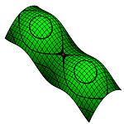


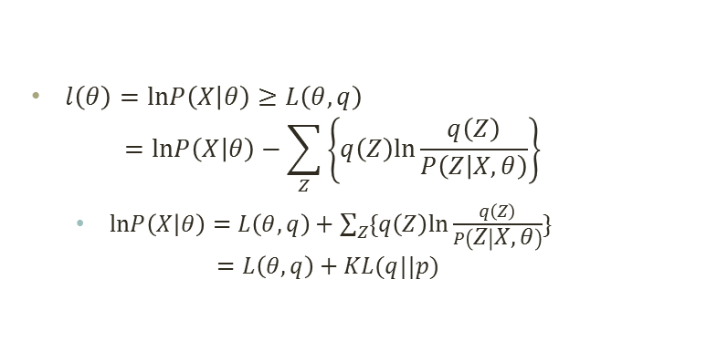
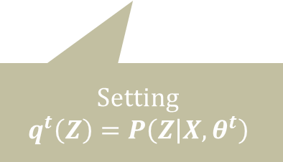











Graphical Interpretation of Lower Bound Maximization
$$q$$
Fall into a local maxima or ???
$l\left(θ\right)=lnP\left(X | θ\right)≥L\left(θ,q\right)$
$=lnP\left(X | θ\right)−\sum_{Z}{\left\{q\left(Z\right)ln\frac{q\left(Z\right)}{P\left(Z | X,θ\right)}\right\}}$
  $lnP\left(X | θ\right)=L\left(θ,q\right)+\sum_{Z}{\{q\left(Z\right)ln\frac{q\left(Z\right)}{P\left(Z | X,θ\right)}\}}$
  $=L\left(θ,q\right)+KL(q||p)$
$$θ$$
  $$KL(q|\left|p\right)$$
  $$KL(q|\left|p\right)=0$$
  $$KL(q||p)$$
Optimize q
Optimize $θ$
$$lnP\left(X | θ\right)$$
$$lnP\left(X | θ^{t}\right)$$
$$lnP\left(X | θ^{t+1}\right)$$
$$L\left(θ,q\right)$$
$$L\left(θ^{t},q\right)$$
$$L\left(θ^{t+1},q\right)$$
Setting
$$q^{t}\left(Z\right)=P\left(Z | X, θ^{t}\right)$$
Setting
$$θ^{t+1}={argmax}_{θ}E_{q^{t}\left(Z\right)}lnP\left(X,Z | θ\right)$$

Slide 10
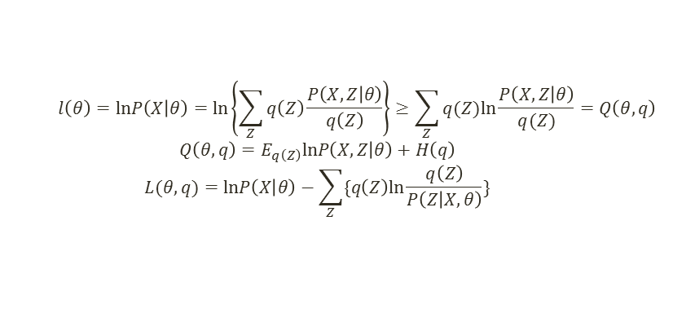
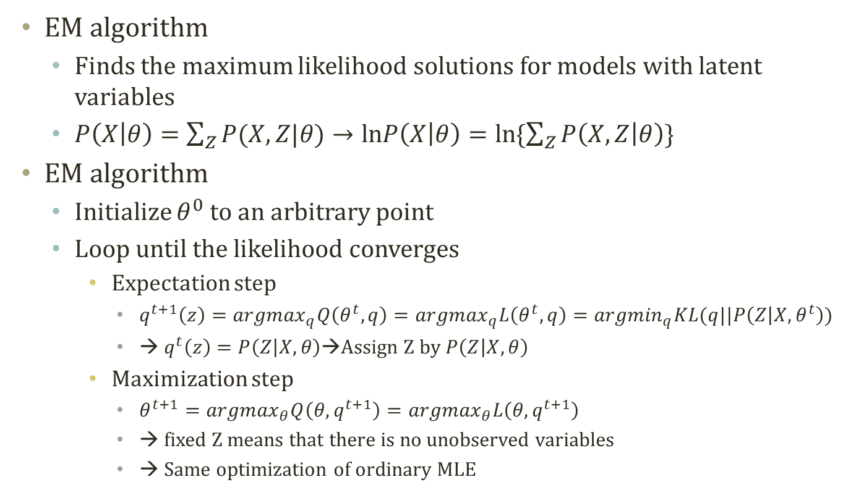
EM Algorithm
  $$l\left(θ\right)=lnP\left(X | θ\right)=ln\left\{\sum_{Z}{q\left(Z\right)\frac{P\left(X,Z | θ\right)}{q\left(Z\right)}}\right\}≥\sum_{Z}{q(Z)ln\frac{P\left(X,Z | θ\right)}{q(Z)}}=Q\left(θ,q\right)$$
  $$Q\left(θ,q\right)=E_{q\left(Z\right)}lnP\left(X,Z | θ\right)+H\left(q\right)$$
  $$L(θ,q)=lnP\left(X | θ\right)−\sum_{Z}{\{q\left(Z\right)ln\frac{q\left(Z\right)}{P\left(Z | X,θ\right)}\}}$$
EM algorithm
  Finds the maximum likelihood solutions for models with latent variables
  $P\left(X | θ\right)=\sum_{Z}{P(X,Z|θ)}→lnP\left(X | θ\right)=ln\{\sum_{Z}{P\left(X,Z | θ\right)}\}$
EM algorithm
  Initialize $θ^{0}$ to an arbitrary point
  Loop until the likelihood converges
    Expectation step
      $q^{t+1}\left(z\right)={argmax}_{q}Q\left(θ^{t},q\right)={argmax}_{q}L\left(θ^{t},q\right)={argmin}_{q}KL(q||P\left(Z | X,θ^{t}\right))$
      → $q^{t}\left(z\right)=P\left(Z | X,θ\right)$→Assign Z by $P\left(Z | X,θ\right)$
    Maximization step
      $θ^{t+1}={argmax}_{θ}Q\left(θ,q^{t+1}\right)={argmax}_{θ}L\left(θ,q^{t+1}\right)$
      → fixed Z means that there is no unobserved variables
      → Same optimization of ordinary MLE

Slide 11
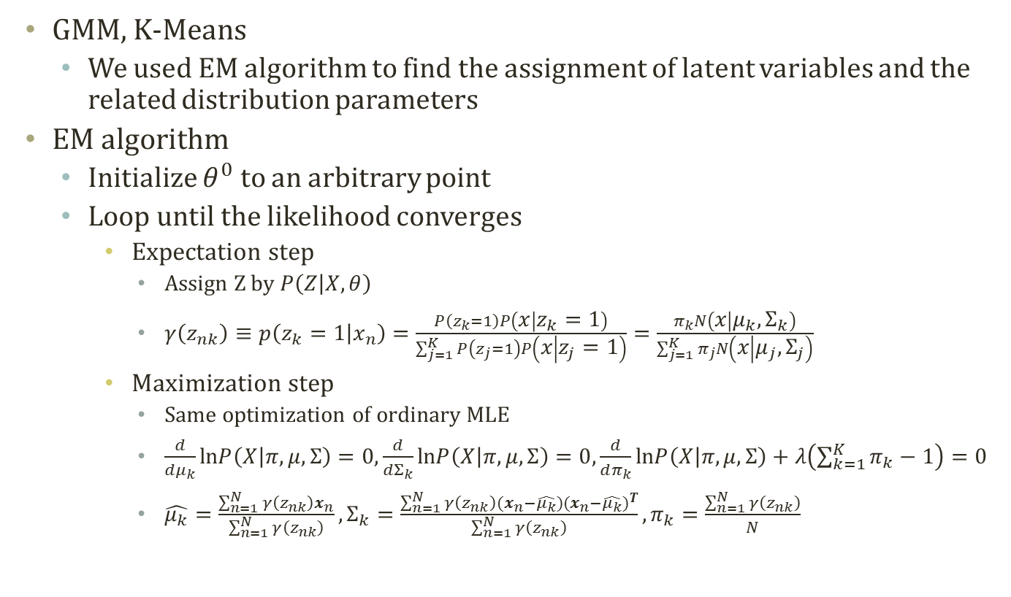
Rethinking GMM Learning Process
GMM, K-Means
  We used EM algorithm to find the assignment of latent variables and the related distribution parameters
EM algorithm
  Initialize $θ^{0}$ to an arbitrary point
  Loop until the likelihood converges
    Expectation step
      Assign Z by $P\left(Z | X,θ\right)$
      $γ\left(z_{nk}\right)≡p\left(z_{k}=1 | x_{n}\right)=\frac{P\left(z_{k}=1\right)P\left(x | z_{k}=1\right)}{\sum_{j=1}^{K}{P\left(z_{j}=1\right)P\left(x | z_{j}=1\right)}}=\frac{π_{k}N\left(x | μ_{k},Σ_{k}\right)}{\sum_{j=1}^{K}{π_{j}N\left(x | μ_{j},Σ_{j}\right)}}$
    Maximization step
      Same optimization of ordinary MLE
      $\frac{d}{dμ_{k}}lnP\left(X | π,μ,Σ\right)=0,\frac{d}{dΣ_{k}}lnP\left(X | π,μ,Σ\right)=0,\frac{d}{dπ_{k}}lnP\left(X | π,μ,Σ\right)+λ\left(\sum_{k=1}^{K}{π_{k}}−1\right)=0$
      $\hat{μ_{k}}=\frac{\sum_{n=1}^{N}{γ\left(z_{nk}\right)}x_{n}}{\sum_{n=1}^{N}{γ\left(z_{nk}\right)}},Σ_{k}=\frac{\sum_{n=1}^{N}{γ\left(z_{nk}\right)}(x_{n}−\hat{μ_{k}}){(x_{n}−\hat{μ_{k}})}^{T}}{\sum_{n=1}^{N}{γ\left(z_{nk}\right)}},π_{k}=\frac{\sum_{n=1}^{N}{γ\left(z_{nk}\right)}}{N}$

Slide 12
Further Readings
Bishop Chapter 2 and 9
Murphy Chapter 11

